Slide 1
Arif Waterproofing & Construction
Evolving with Time Yet Committed to Excellence through Innovation…

Slide 2
About
# Contributing since 1985
# Trusted name in the developer industry
# Excellent and experienced workers
# Best quality materials

Slide 3
Services We Provide
# Water and damp proofing
# Heat proofing
# Damp repairing
# Crack repairing
# Leakage repairing

Slide 4
Application Areas
# Rooftop
# Planter
# Terrace and cornice
# Basement floor and retaining wall
# Washroom
# Swimming pool
# Water body
# Water tank and reservoirs

Slide 5
Materials
# Bitumen Torch Membrane
# Bitumen Self-adhesive membrane
# Bitumen Roofing Felt
# Cementation Materials
# Crack & Leakage Injections

Slide 6
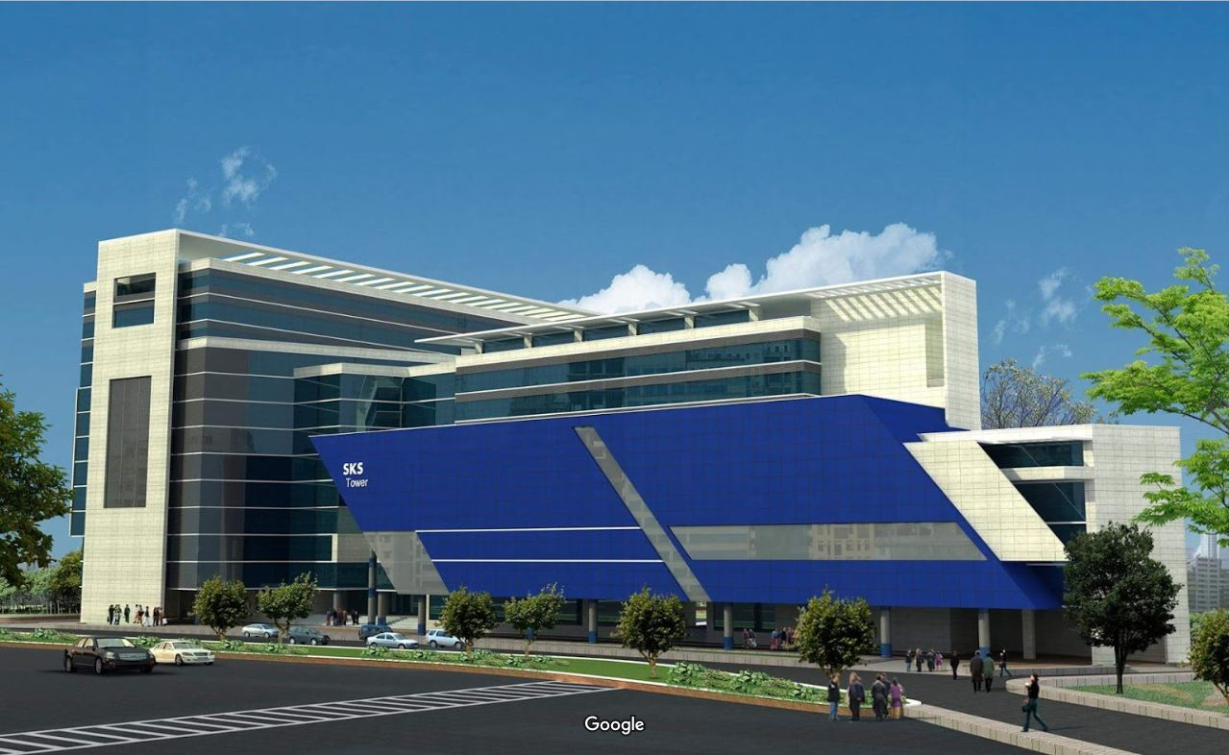
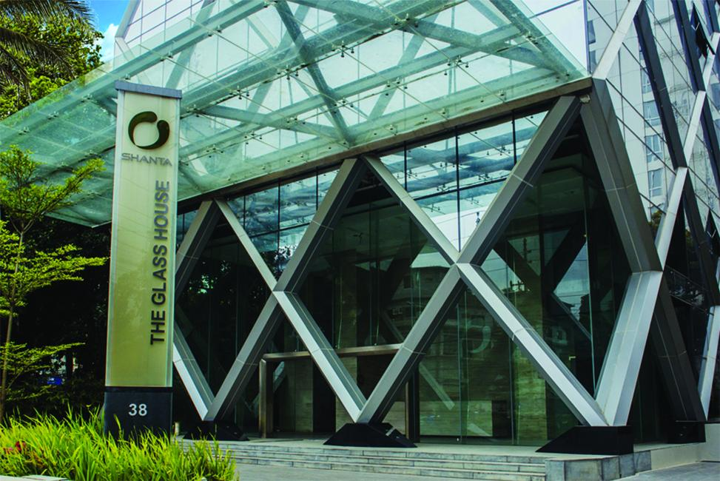
Notable Projects
Glass House (Gulshan)
SKS Tower Dhaka

Slide 7
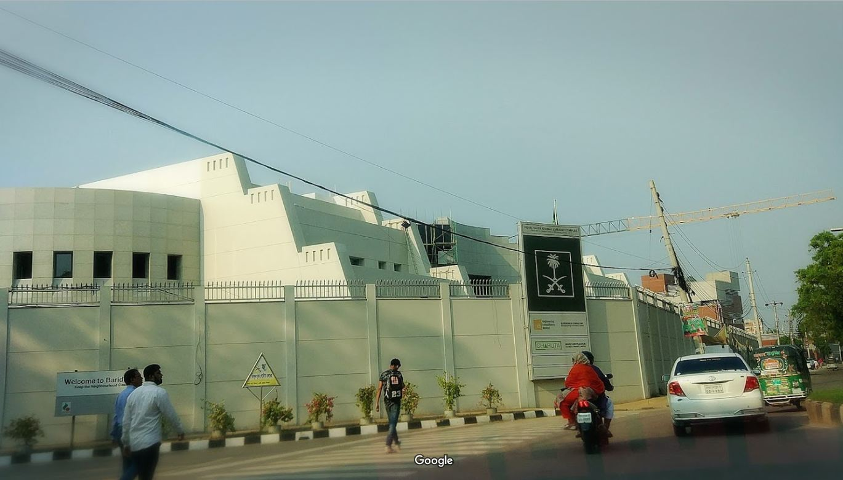
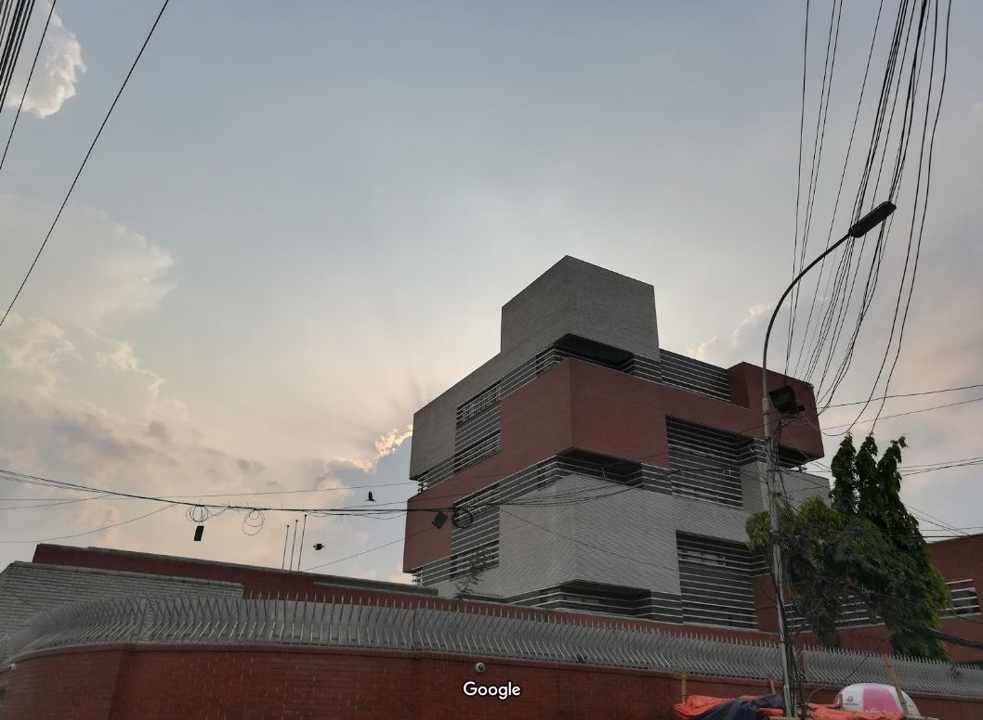
Notable Projects
Embassy of the Federal Republic of Germany
Royal Embassy Of Saudi Arabia

Slide 8
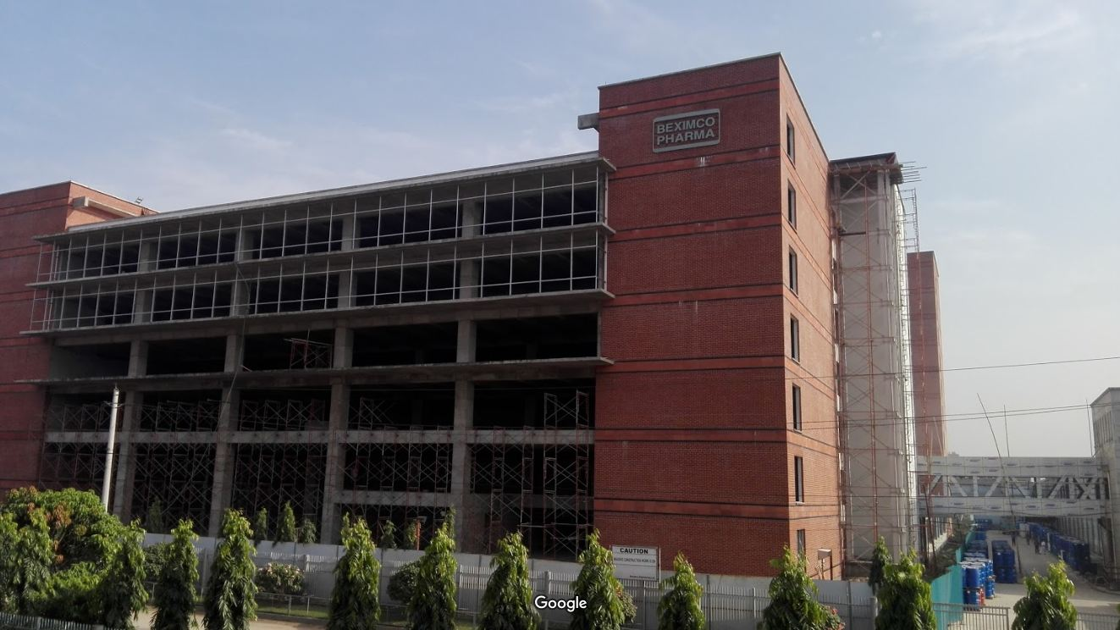
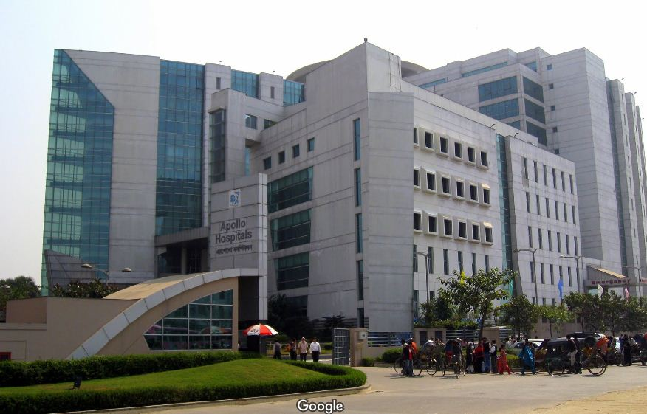
Notable Projects
STS Group Apollo Hospitals
Beximco Pharmaceuticals Building (Tongi)

Slide 9
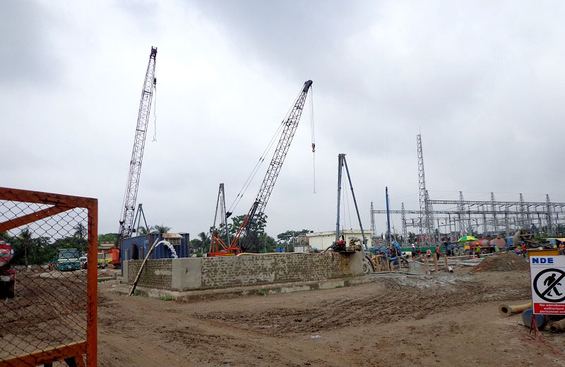
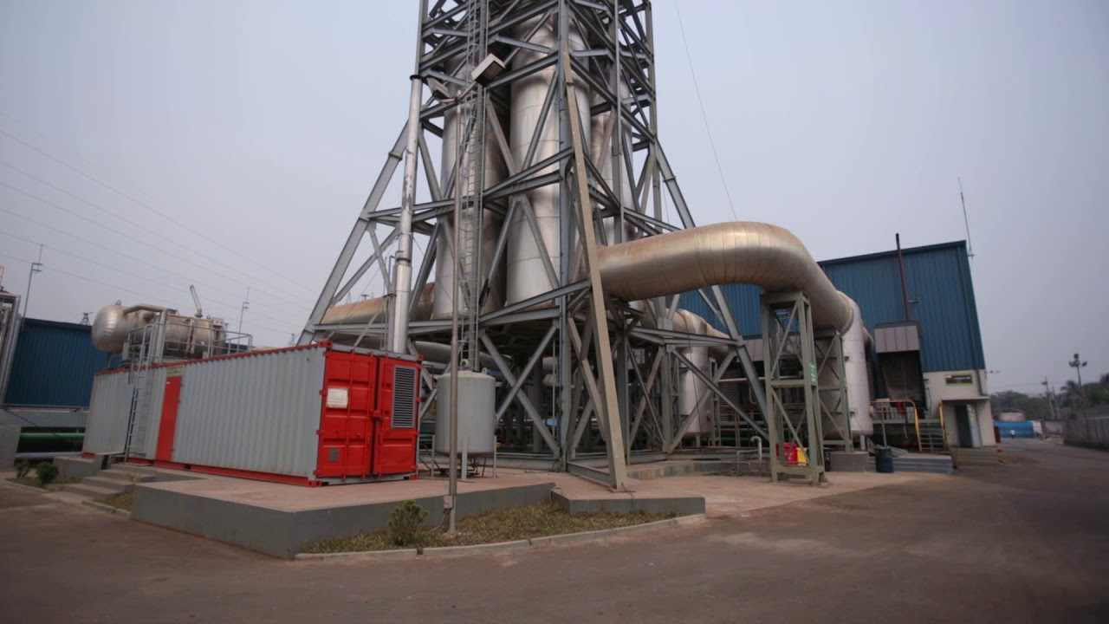
Notable Projects
CHB-WGMEC Consortium
Summit Power Plant (Narayanganj)
NDE Sirajganj Power Plant

Slide 10
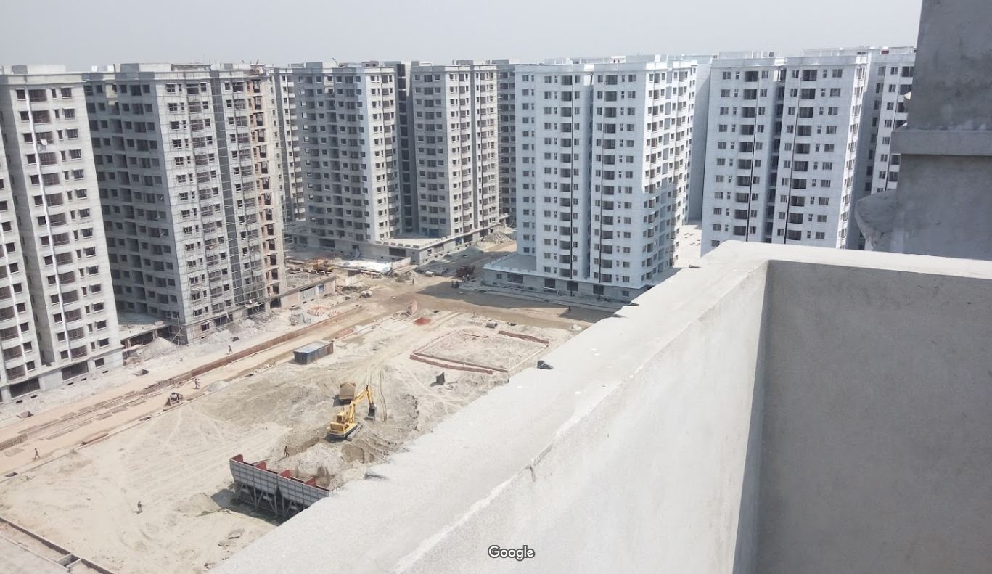
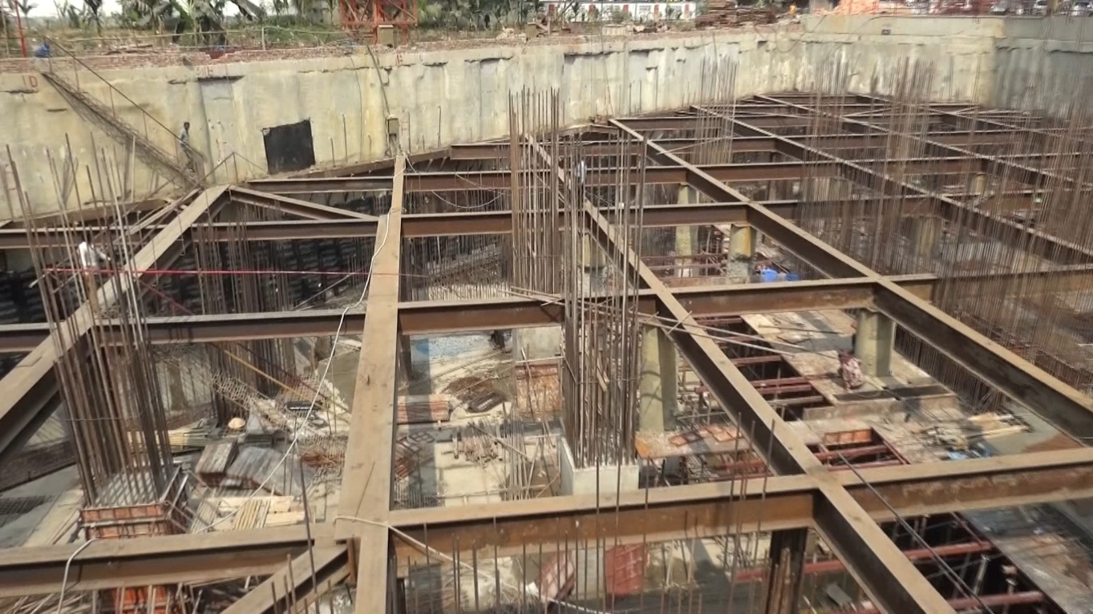
Notable Projects
Union Group Dhaka Convention Center (Bashundhara R/A)
RAJUK Apartment Project

Slide 11
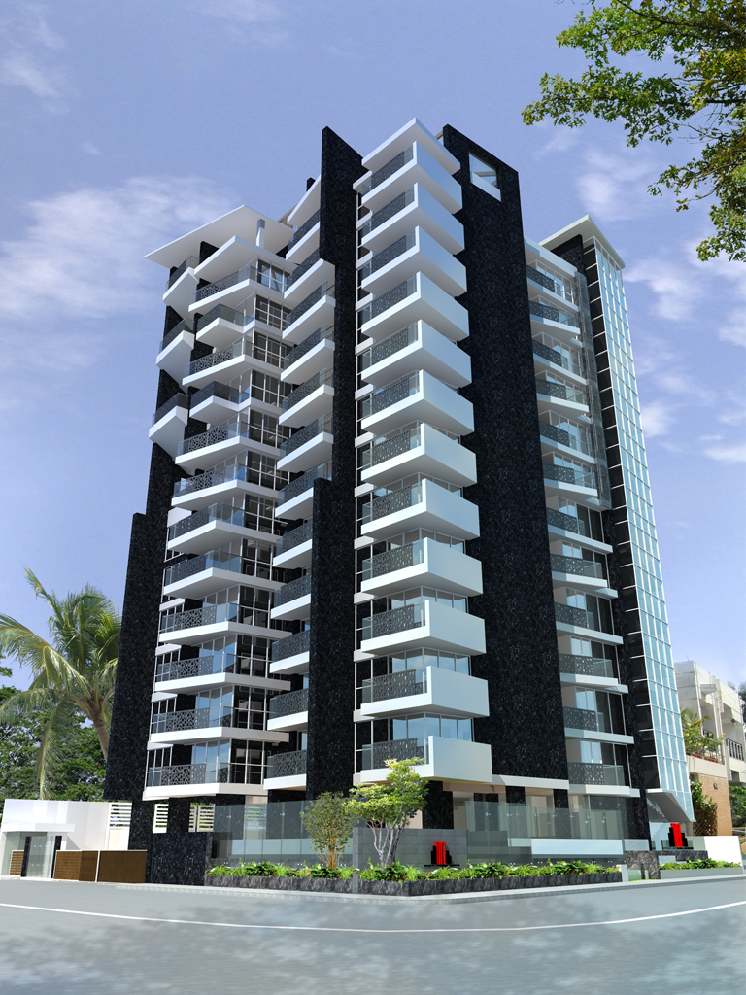
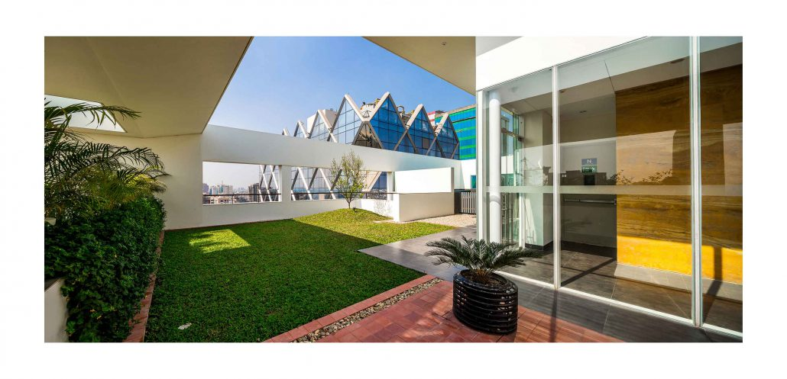
Notable Projects
Bay’s Brookwood (Gulshan-1)
Navana Chez de Sofia
(Gulshan-2)

Slide 12
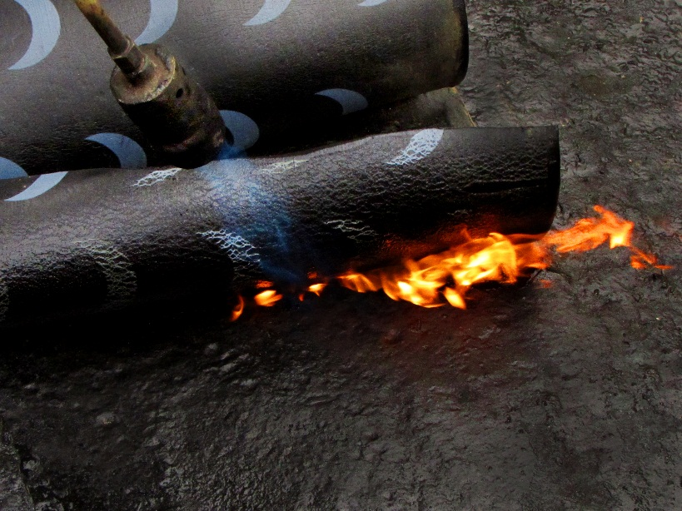
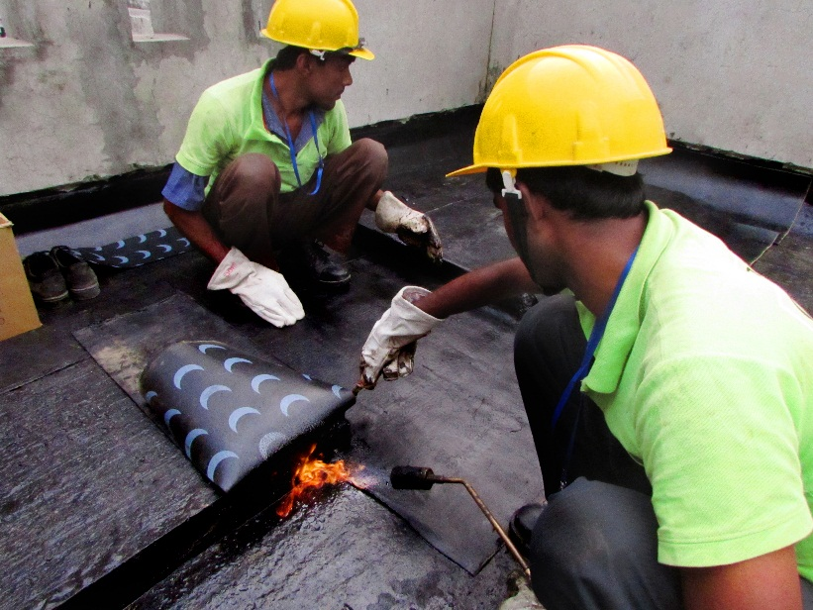
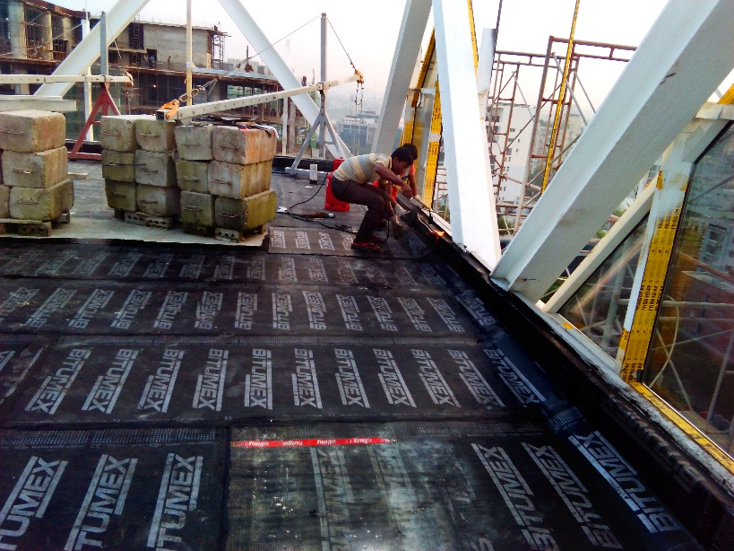
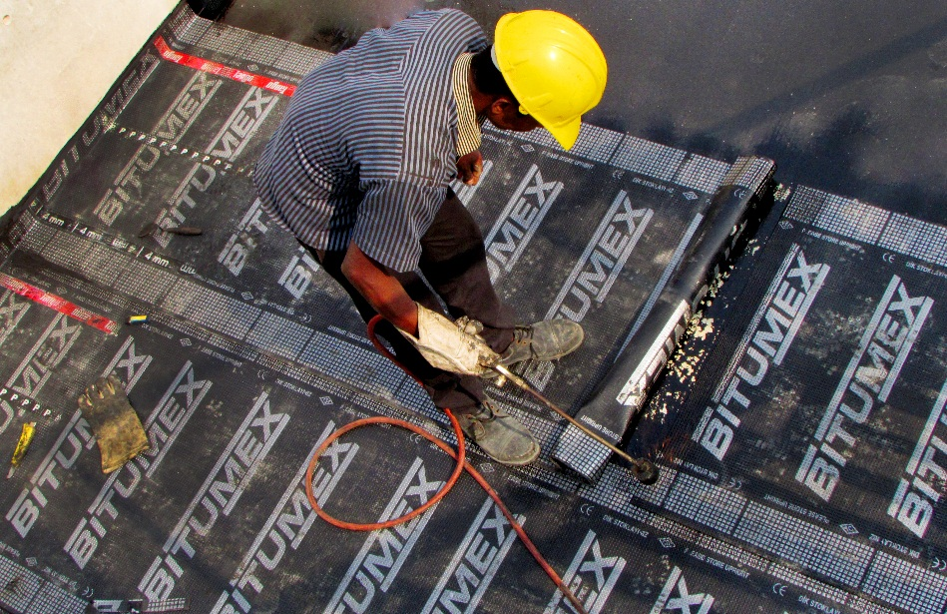
Work Gallery

Slide 13
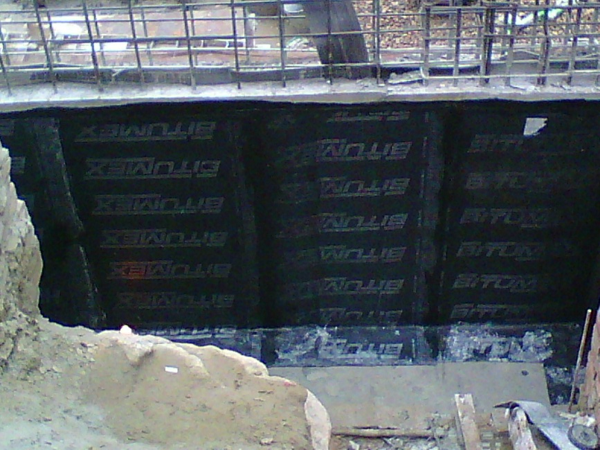
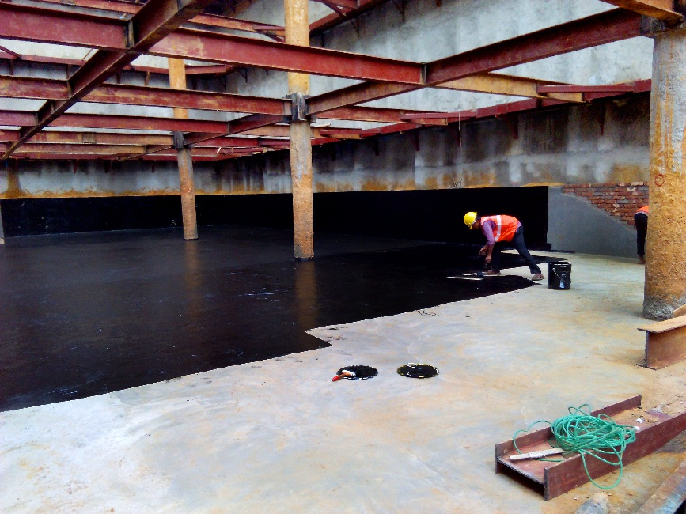
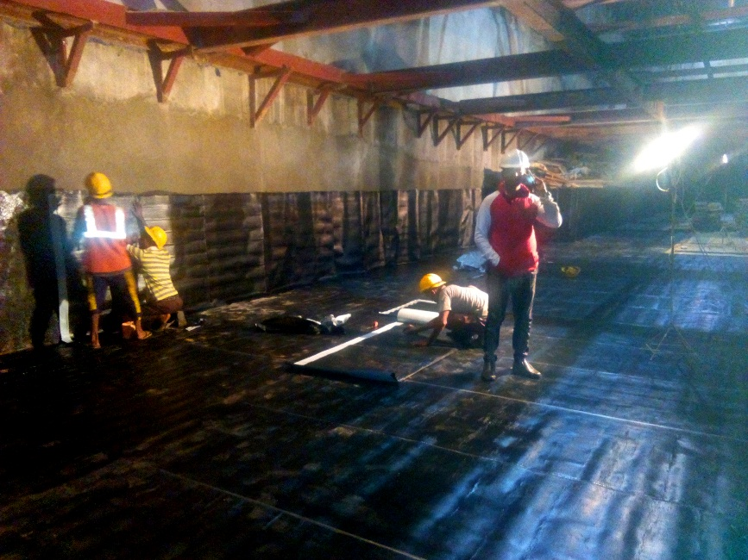
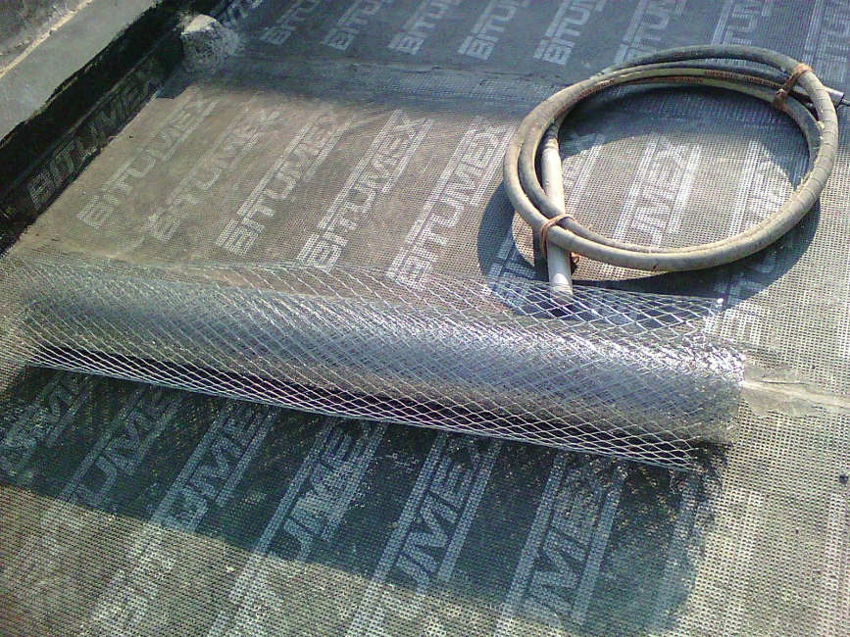
Work Gallery

Slide 14
Thank You for Your Patience…

